Slide 1

Interchangeability and Substitutability (I&S)

Slide 2
Objectives
What is I&S
Order of Use Codes
Interchangeability vs. Substitutability
Visual examples
How to add, delete or adjust OOU in D143 (link/delink)
TBA Task
004.011- Change or establish the Order of Use (OOU) code(s) for a specific NSN
Regs
AFMCMAN23-103

Slide 3

What is I&S
Lay Terms
Book Answer
I & S is a Verified Substitute
The overall goal of Interchangeability and Substitutability (I&S) is to provide for supply sustainment and, at times, may lead to the elimination of duplicate items.
Used to group like items
The objective of I&S are as follows:
Identifying items for subsequent single management assignments.
Provide a standard method of Inter-Service/Agency (S/A) I&S communications
Ensure no duplication on multi-used items
Provide DOD standard systems and procedures to the maximum extent possible.
Using DOD standards to automate data processing techniques in support of I&S program.
To provide guidance to resolve differences involving I&S family structures, master item designations, and single management assignments.

Slide 4

Order of Use Codes
The Order of Use Codes are a three digit code that are assigned in an I&S group to arrange the NSNs in order of preference. The lead Service/Agency make the determination what the order of use will be and any changes the need to be made to the group.
First Position: Group-The First position will always be “A”, the first NSN will always be AAA
AAA AAB
AAC
AAD

Slide 5
Order of Use Codes
Second Position: Subgroup- The Second position in a group will identify One-Way or Two-Way.
One Way: When the alpha character changes, the relationship is substitutable
Two Way: When the alpha character stays the same the relationship is interchangeable.
One-Way (Substitute)
ACA
ABA
AAA
Two-Way (Interchangeable)
AAC
AAB
AAA

Slide 6
Order of Use Codes
Third Position: Order within Subgroup
The Third position is only important in a two-way relationship and it shows order.
Mix of One-Way and Two Way Relationships
ABB
ABA
AAA

Slide 7
Interchangeability vs. Substitutability
Substitutable Item-
(One-Way)- An item that possesses such functional and physical characteristics as to be capable of being exchanged for another only under specified conditions or for particular applications and without alteration of the items themselves or of adjoining items.
Interchangeable Item (Two-Way)- An item that possesses such functional and physical characteristics as to be equivalent in performance, reliability, and maintainability to another item of similar or identical purposes; and is capable of being exchanged for the other item without selection for fit or performance, and without alteration of the items themselves or of adjoining items, except for adjustment.

Slide 8
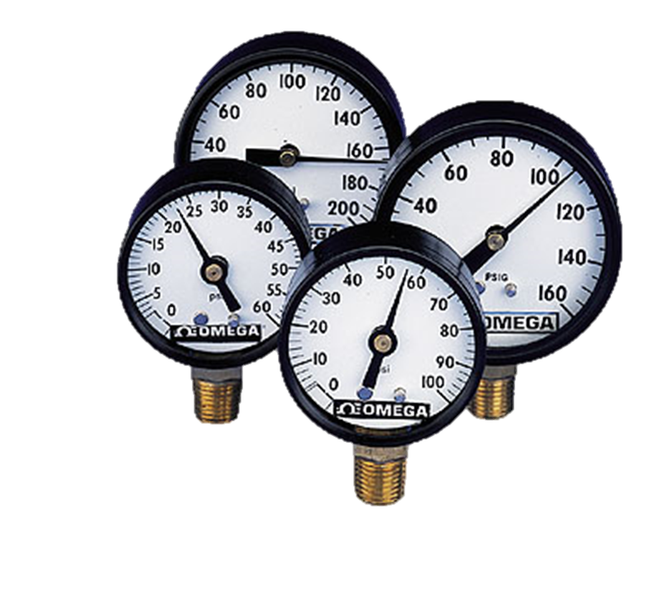
Substitutability
Master or Most preferred
ADA
ACA
These four air pressure gages show what could be a substitutable I&S group.
Notice the master NSN displays a range of 0 to 200 PSI, thus can be substituted for each of the other 3 members. However the members can be substituted for other members with a lower order-of-use.
Not all these have the same capabilities but depending on the requirements they could be suitable.
AAA
ABA
Gage, Air Pressure

Slide 9
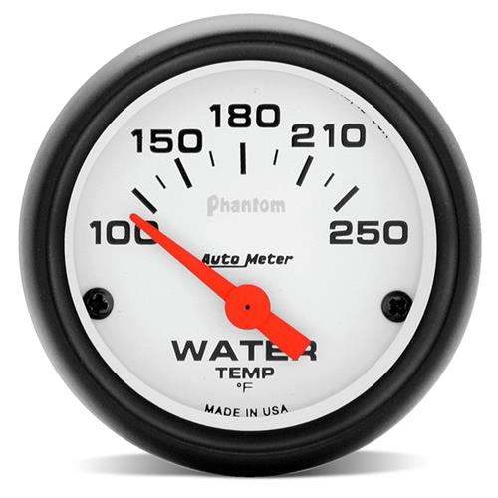
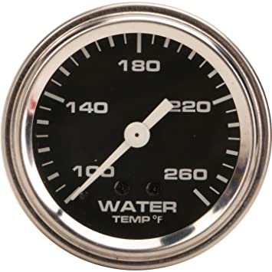

Interchangeability
These three thermometers show what could be an Interchangeable Group.
All three display can show a range from 160 to 220 degrees Fahrenheit.
Same function different look.
Therefore they are interchangeable with each other.
AAA
AAB
AAC
(Master NSN)

Slide 10

Order of Use Codes
One-Way Relationship (Substitute)
ACA
ABA
AAA
Two-Way Relationship (Interchangeable) & Generic
AAC
AAB
AAA
Mix of One-Way and Two Way Relationships
ABB
ABA
AAA

